Slide 1
Data Structures
ICT-1211
Information and Communication Technology
Lecture-11
Date:

Slide 2
Linked Lists

Slide 3
LINKED LISTS: Searching
Given:
    LIST- a linked list in memory (Unknown/Unseen)
    ITEM- a specific information.
Objective: Finding the location LOC of the node where ITEM first
appears in LIST.
Here, TWO searching algorithm will be discussed for finding the location of LOC of the node where ITEM first appears in LIST.
Algorithm-1 for LIST is Unsorted
Algorithm-2 for LIST is Sorted.

Slide 4
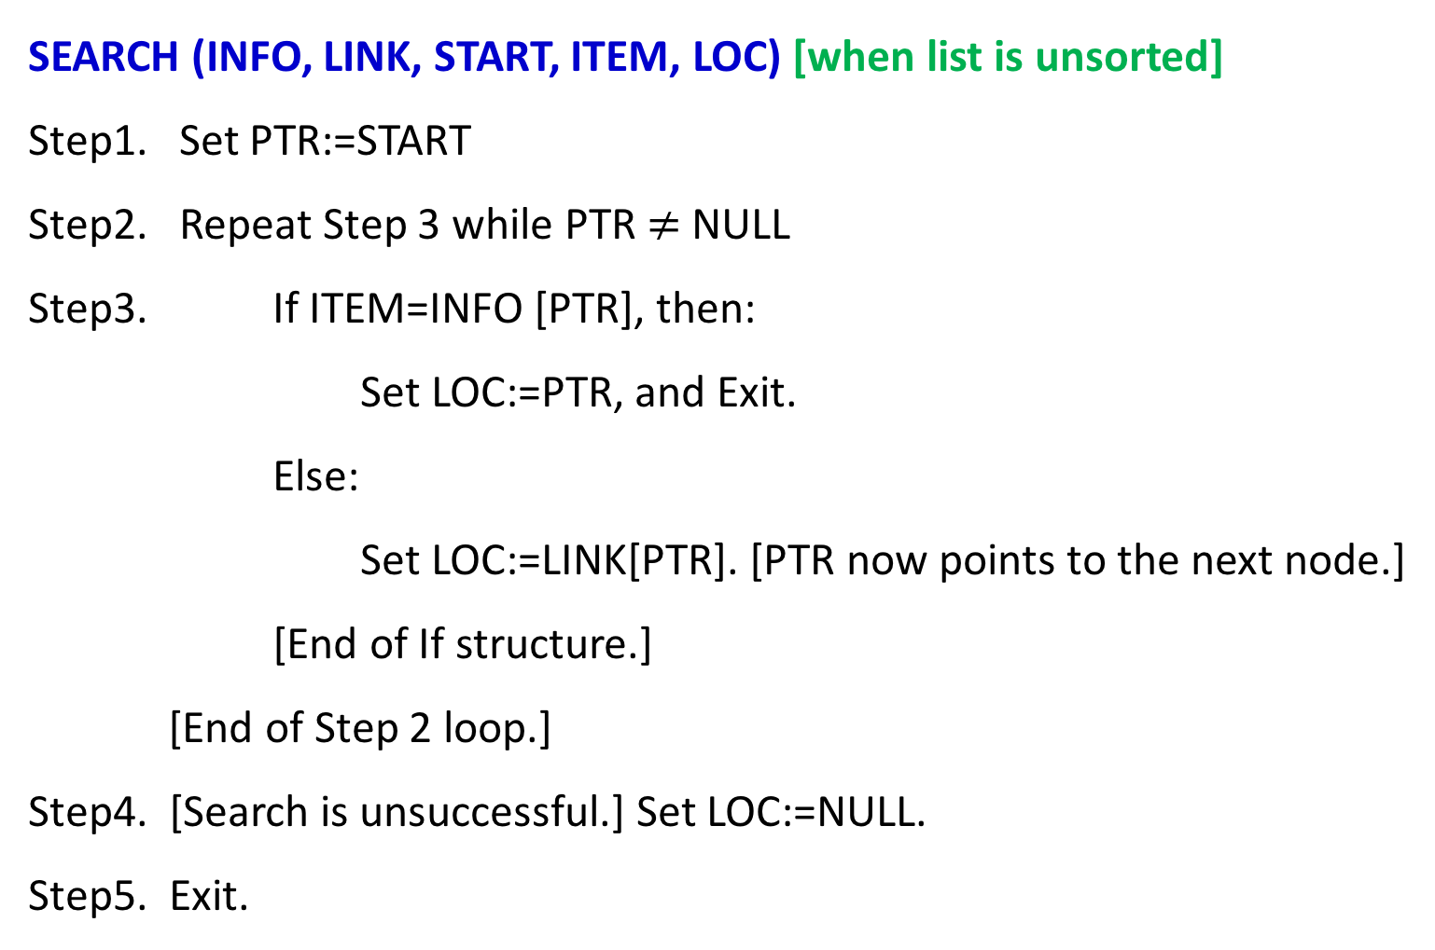
LINKED LISTS: Searching Algorithm-1
SEARCH (INFO, LINK, START, ITEM, LOC) [when list is unsorted]
Step1. Set PTR:=START
Step2. Repeat Step 3 while PTR $≠$ NULL
Step3. If ITEM=INFO [PTR], then:
Set LOC:=PTR, and Exit.
Else:
Set LOC:=LINK[PTR]. [PTR now points to the next node.]
[End of If structure.]
[End of Step 2 loop.]
Step4. [Search is unsuccessful.] Set LOC:=NULL.
Step5. Exit.

Slide 5
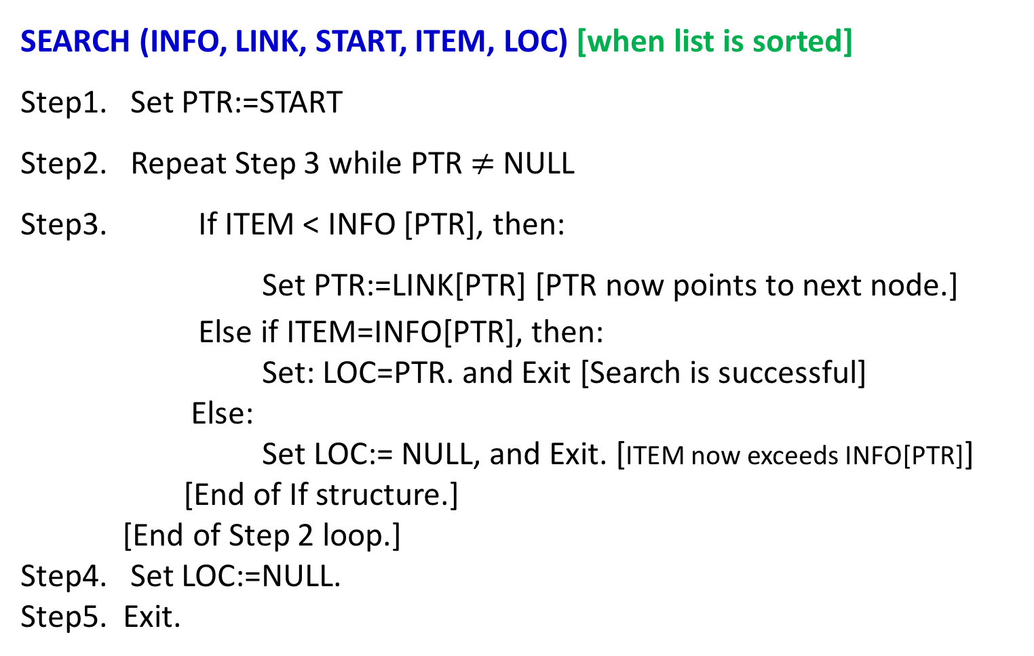
LINKED LISTS: Searching Algorithm-2
SEARCH (INFO, LINK, START, ITEM, LOC) [when list is sorted]
Step1. Set PTR:=START
Step2. Repeat Step 3 while PTR $≠$ NULL
Step3. If ITEM < INFO [PTR], then:
Set PTR:=LINK[PTR] [PTR now points to next node.]
Else if ITEM=INFO[PTR], then:
Set: LOC=PTR. and Exit [Search is successful]
Else:
Set LOC:= NULL, and Exit. [ITEM now exceeds INFO[PTR]]
[End of If structure.]
[End of Step 2 loop.]
Step4. Set LOC:=NULL.
Step5. Exit.
Descending Order Sorted LIST
Any change in algorithm for Ascending Order Sorted LIST?

Slide 6
LINKED LISTS: Searching Algorithm
Limitations:
NB. A binary search algorithm cannot be applied to a sorted linked list.
Since, there is no way of indexing the middle element in the list.
The main drawbacks in using a linked list as data structure

Slide 7
LINKED LISTS: Memory Allocation
The maintenance of linked lists in memory assumes the possibility of …...
    Inserting new nodes into the lists, and
    Deleting nodes from the list.
Hence, requires some mechanism which provides:
    Unused memory space for the new nodes.
    Deleted nodes becomes available for future use.
To meet the necessities….....

Slide 8
LINKED LISTS: Memory Allocation
Together with the linked lists in memory, a special list is maintained which consists of unused memory cells.
This list, which has its own pointer, is called …
    The list of available space or
    the free-storage list or
    the free pool.

Slide 9
LINKED LISTS: Memory Allocation
Here, linked lists are implemented by parallel arrays.
Suppose INSERTIONS and DELETIONS are to be performed on our linked lists.
Then the unused memory cells in the arrays will also be linked together to form a linked list using AVAIL as its list pointer variable.
LIST(INFO, LINK, START, AVAIL)

Slide 10
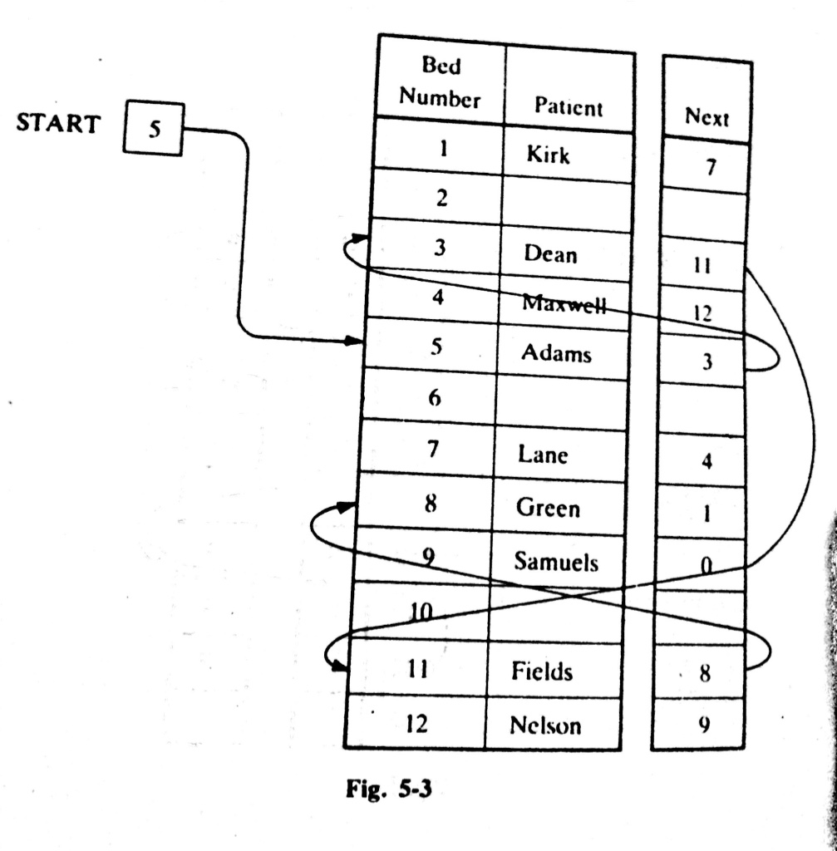
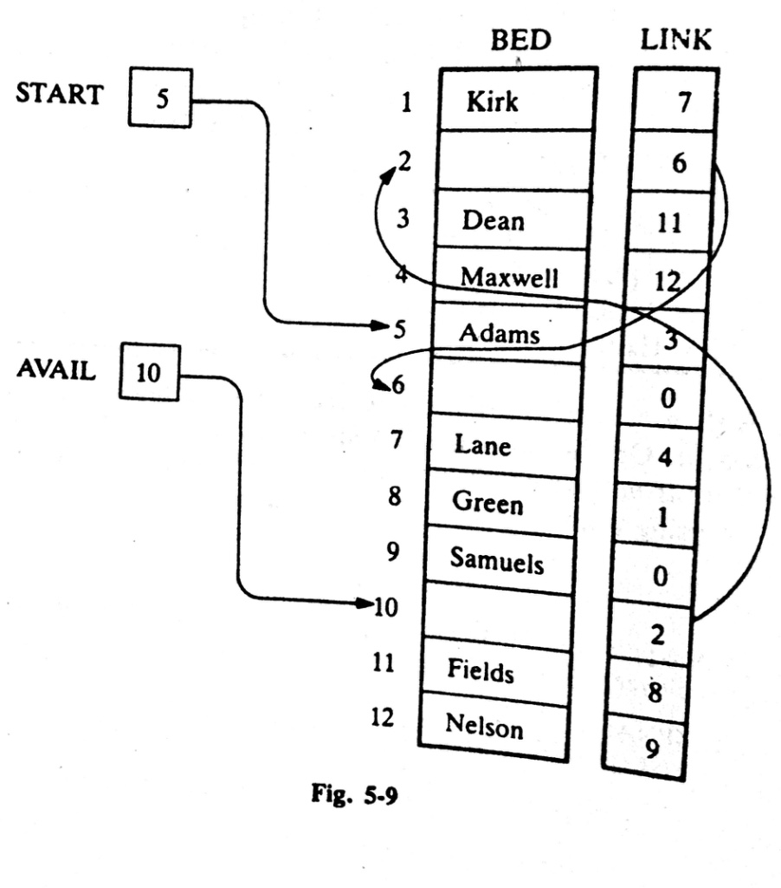
LINKED LISTS: Example 5.10

Slide 11
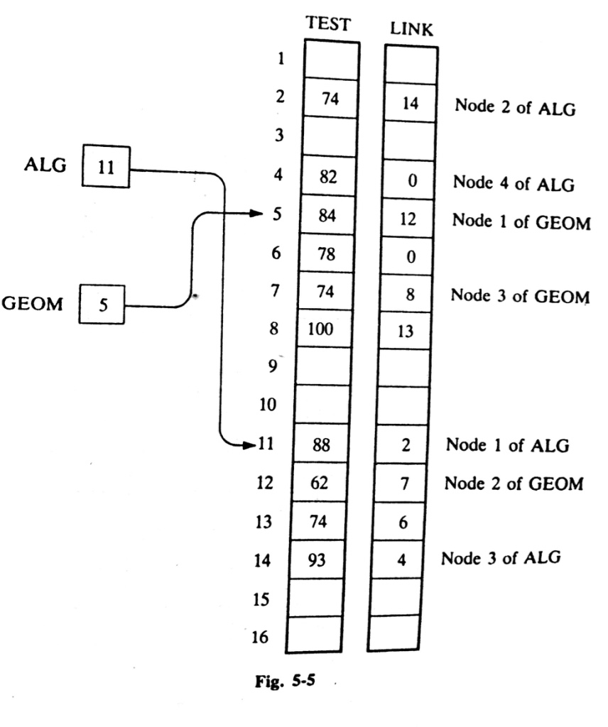
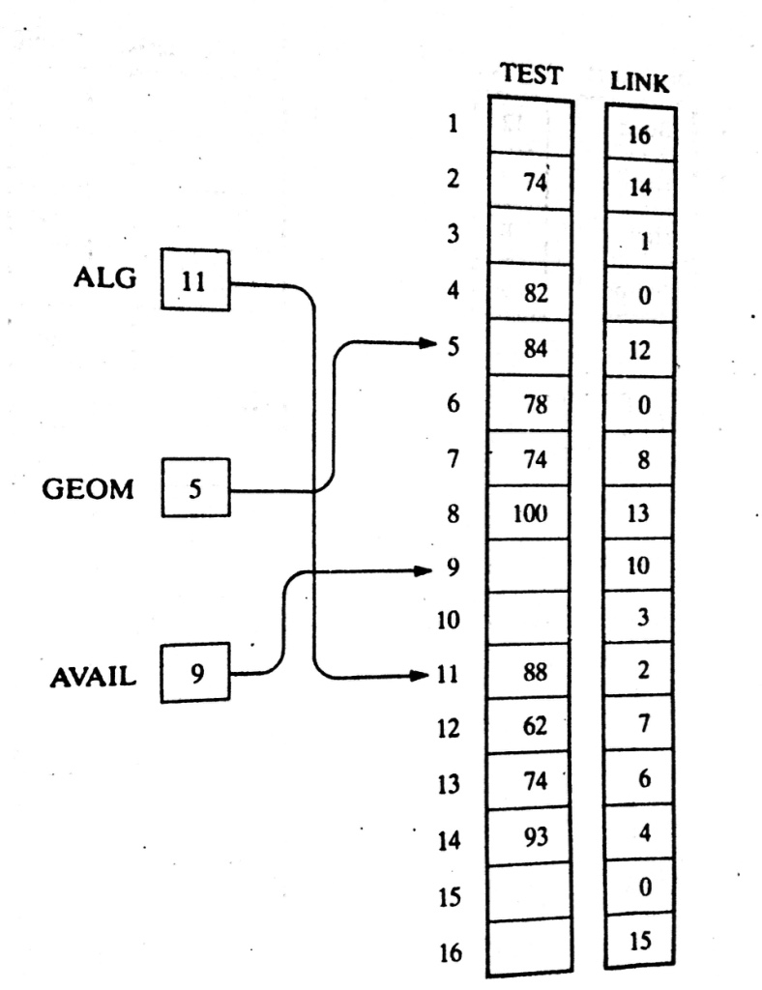
LINKED LISTS: Example 5.11(a)

Slide 12
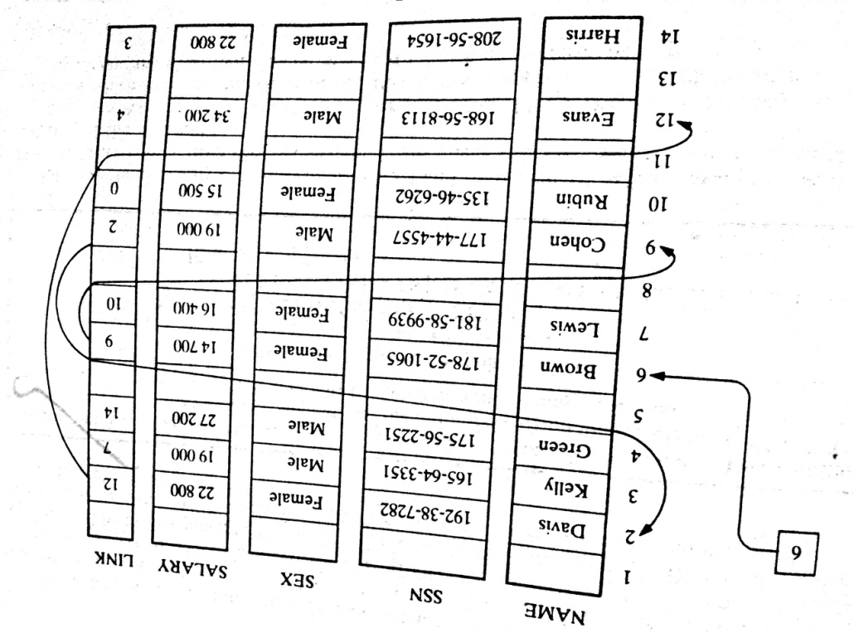
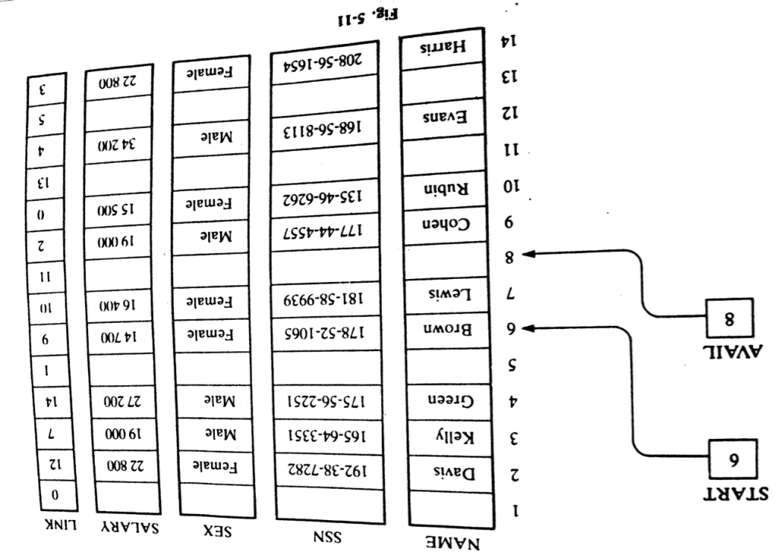
LINKED LISTS: Example 5.11(b)

Slide 13
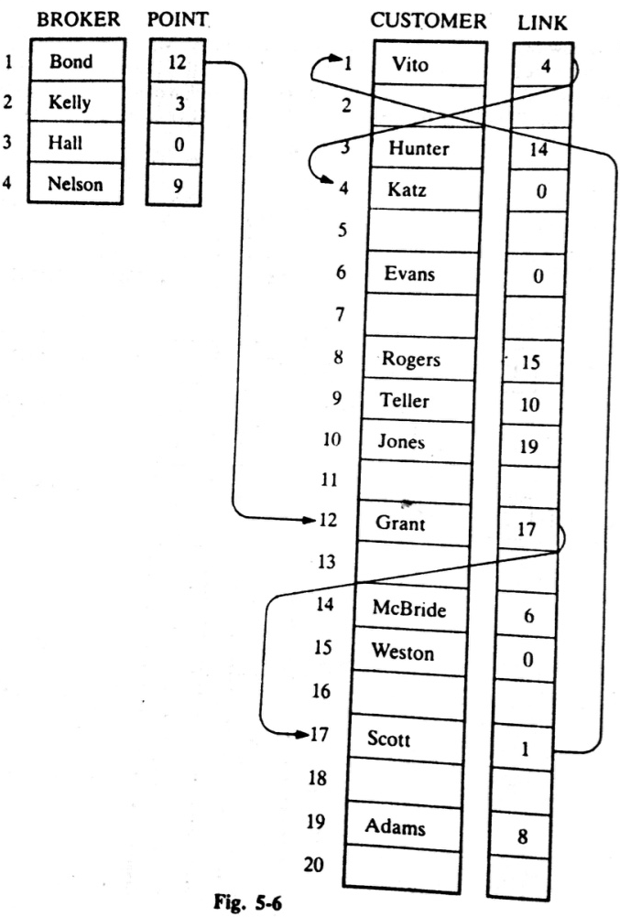
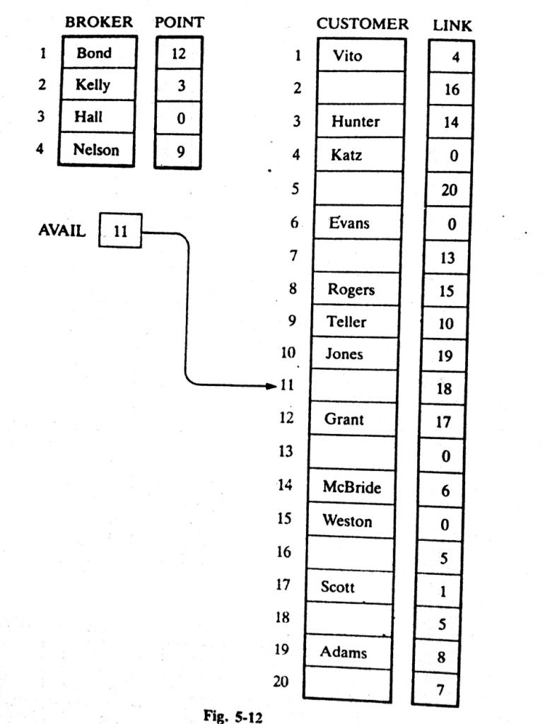
LINKED LISTS: Example 5.11(c)

Slide 14
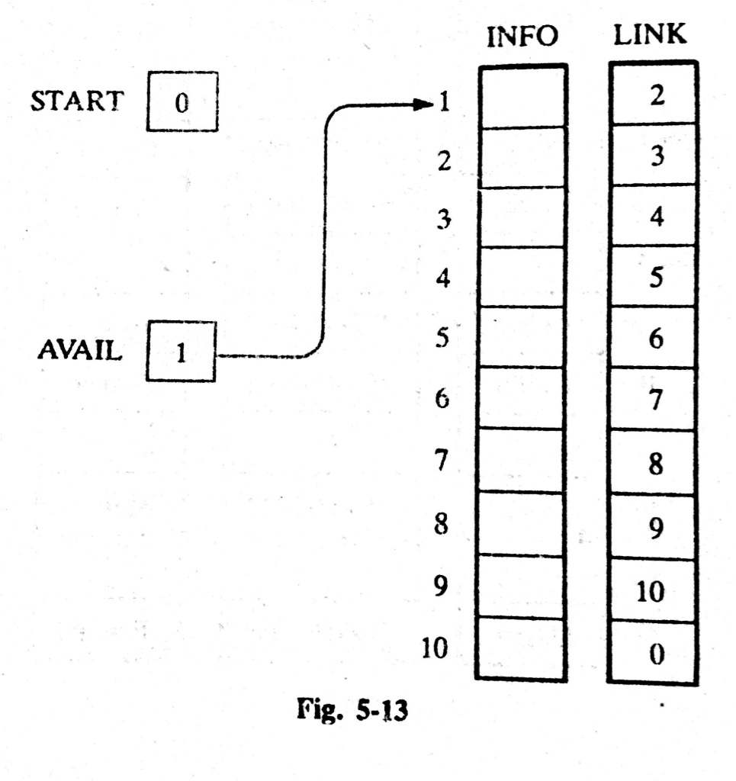
LINKED LISTS: Example 5.12
Suppose LIST(INFO, LINK, START, AVAIL) has memory space for n=5 nodes,
Furthermore, suppose LIST is initially empty.
Your INSTATNT Task
Show the LINKED LIST which consists of START, AVAIL, INFO, LINK

Slide 15
LINKED LISTS: Garbage Collection
Time Consuming Method for OS:
Time Efficient Method for OS:
The OS of a computer may periodically collect all the deleted space onto the free-space list. Any technique which does this collection is called garbage collection.
Garbage Collection usually takes place in TWO steps:
  Firstly, the Computer runs through the memory, tagging those cells which are currently in use, and
  Then, computer runs through the memory, collecting all untagged space onto the free-storage list.

Slide 16
LINKED LISTS: Garbage Collection
When garbage collection task executed by Computer?
The garbage collection may take place when …....
  There is only some minimum amount of space in the free-storage list, or
  There is no space at all left in the free-storage list, or
  When the CPU is idle and has time to do the collection
The garbage collection is invisible to the programmer

Slide 17
LINKED LISTS: Overflow
Sometimes new data are to be inserted into a data structure but there is no available space (the free-storage list is empty).
This situation is usually called Overflow.
Usually, Overflow will occur with our linked list when AVAIL=NULL and there is an insertion.
How we can handle Overflow situation?
We may handle the Overflow situation by….......
  Printing the message OVERFLOW
  We may modify the program by adding space to the underlying arrays

Slide 18
LINKED LISTS: Underflow
Sometime someone wants to delete data from a data structure where the data structure is empty. This situation is usually called Underflow.
Usually, underflow will occur with our linked lists when START=NULL and there is a deletion.
How we can handle Underflow situation?
We may handle the Overflow situation by….......
  Printing the message UNDERFLOW

Slide 19
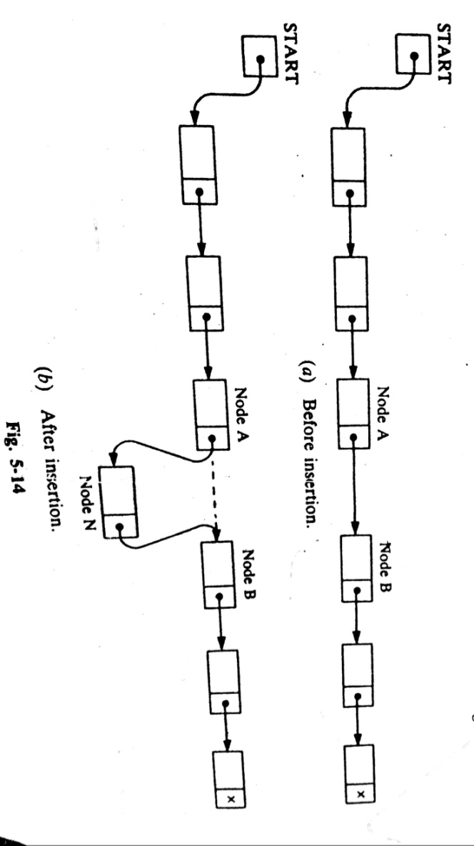
LINKED LISTS: Insertion
Let LIST be a linked list with successive nodes A and B. Suppose, a node N is to be inserted into the list between nodes A and B.
Here, it does not take into account the memory space for the new node N will come from the AVAIL list.
But…..for easier processing, the first node in the AVAIL will be used for the new node N.

Slide 20
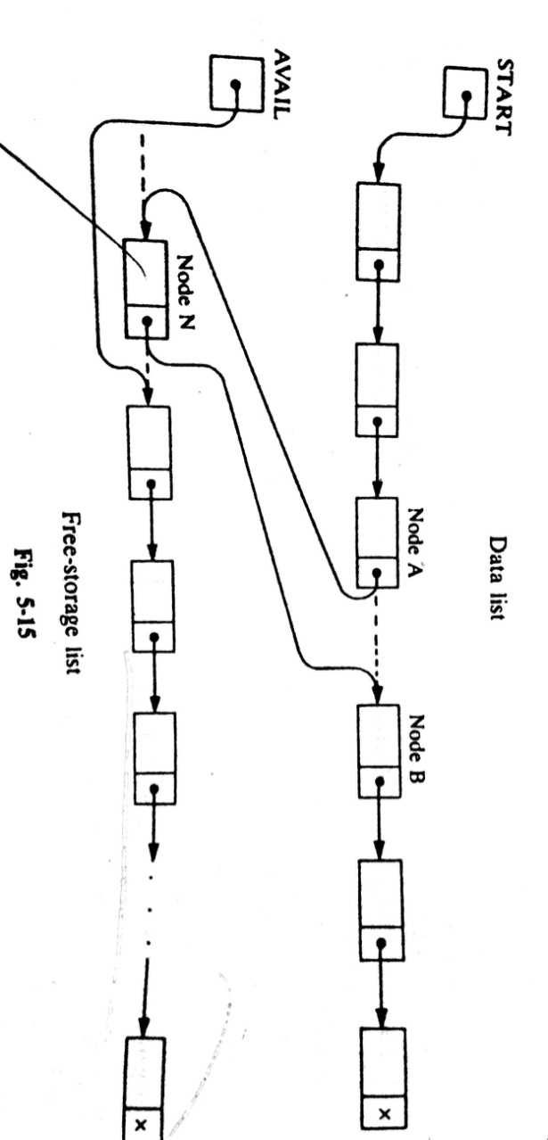
LINKED LISTS: Insertion
More exact Illustration of such an insertion
Here, THREE pointer fields are changed: ???
Which are?
The nextpointer field of node A now points to the new node N.
AVAIL now points to the second node in the free pool.
The nextpointer field of node N now point to node B.

Slide 21
LINKED LISTS: Insertion
There are also TWO special cases:
  If the new node N is the first node in the list, then START will point to N, and
  If the new node is the last node in the list, then N will contain the null pointer.

Slide 22
Thank you……

